Slide 1
Year 7-9 Academic Pathway Planning
Elective Choices for 2022

Slide 2
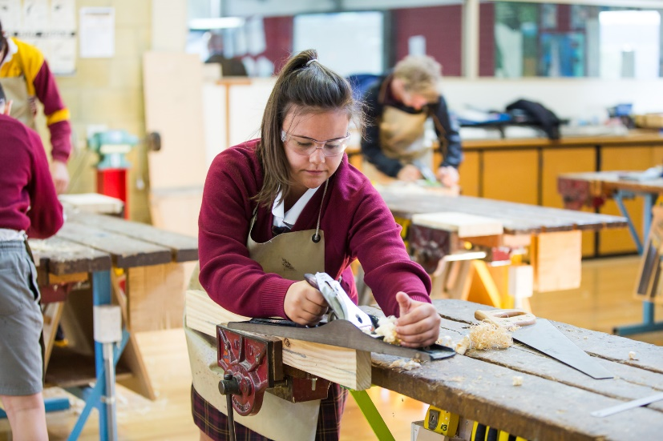
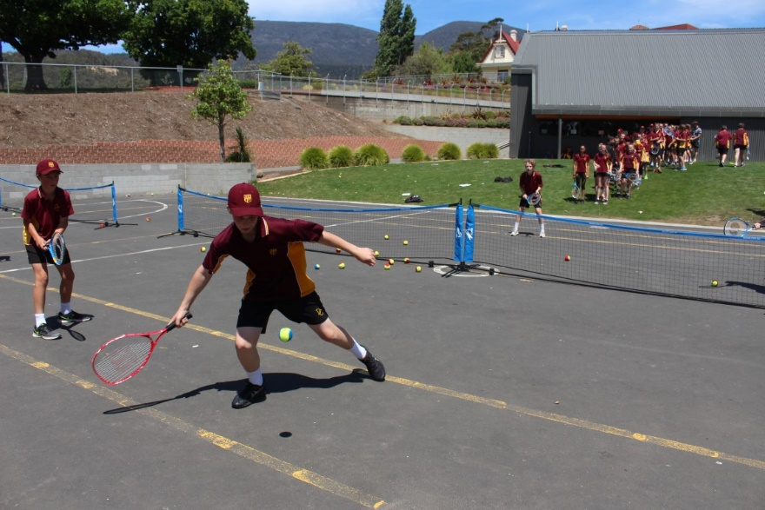

Academic Pathways 2022
The Opportunity to Choose

Slide 3

SEQTA Welcome Page
The SEQTA Welcome Page provides access to videos and PowerPoints related to choosing elective subjects available for 2022
Use the Navigation Buttons at the top of the SEQTA Welcome Page to access information on how to choose an elective

Slide 4

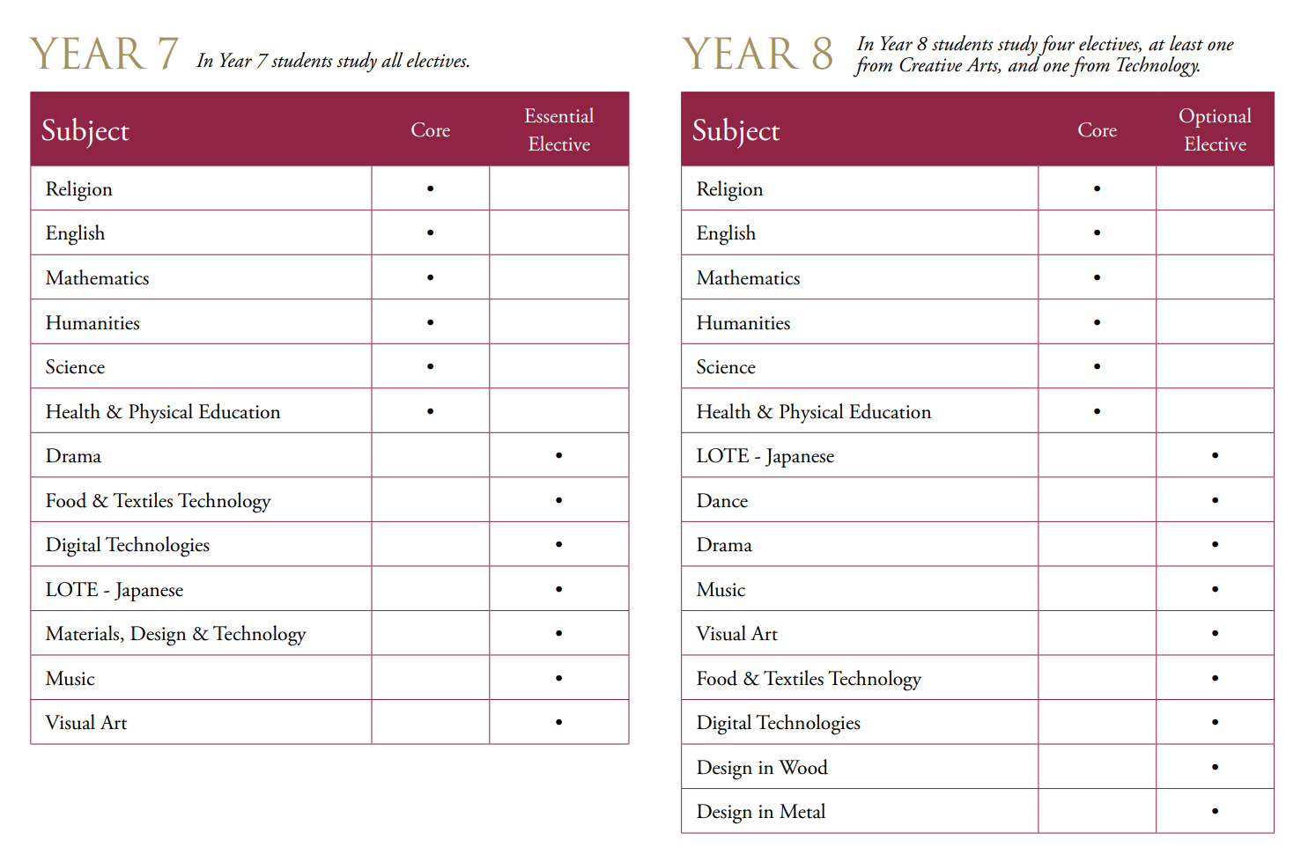


Slide 5
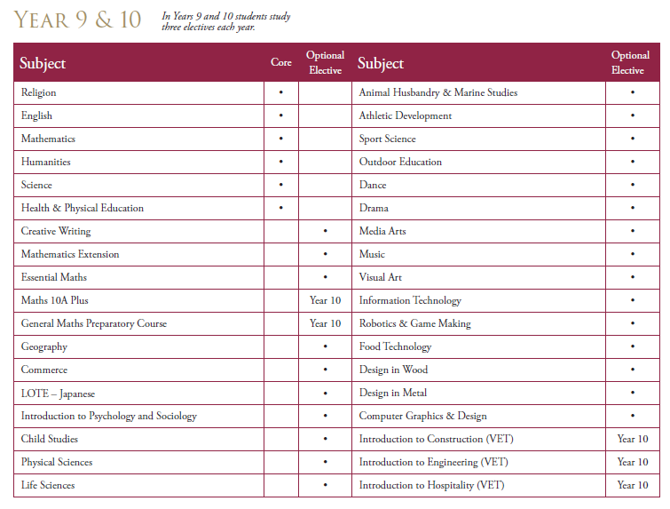

Slide 6
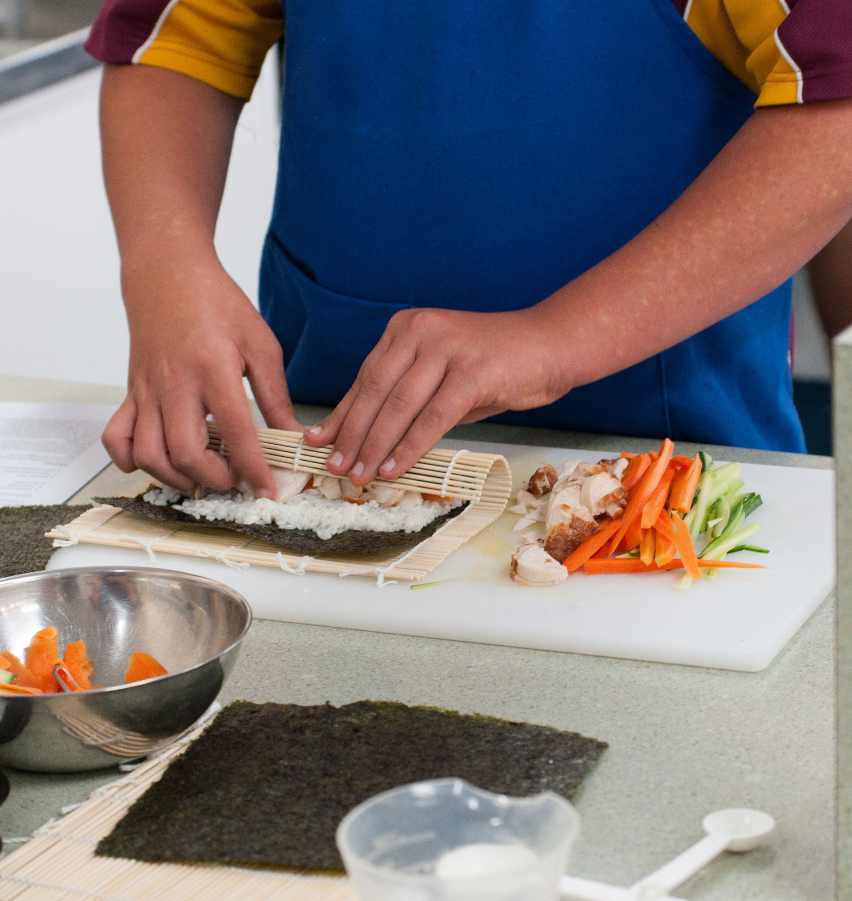
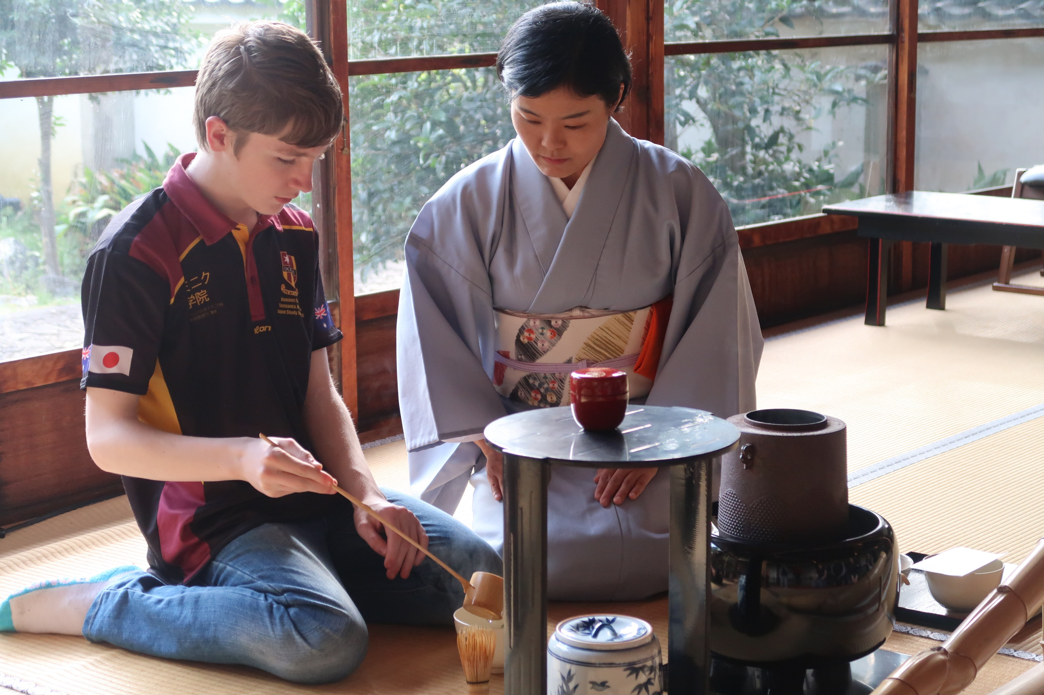
What to consider when choosing electives
Interests
Possibilities
Passions
Strengths
Enjoyment
Balance
Challenge
Senior Secondary Studies Program
Career Pathway

Slide 7
Seek further information
In addition to the information provided in our Subject Handbook, families can find further details about particular subjects by clicking on links and videos in this webpage. Join one of our Microsoft Teams subject area meetings to find out more or contact the Faculty Coordinators, elective teachers or your child's Pastoral Group Teacher.
Use the link below to access Dominic College’s Staff Profile Page. Contact details for each teacher are available on this site:
https://www.dominic.tas.edu.au/our-college/college-staff

Slide 8

Web Preferences
Our Subject Selection process is managed online through our Web Preferences platform. Elective choices open on Thursday 17 June and will close on Friday 25 June.
Instructions have been emailed to students.

Slide 9
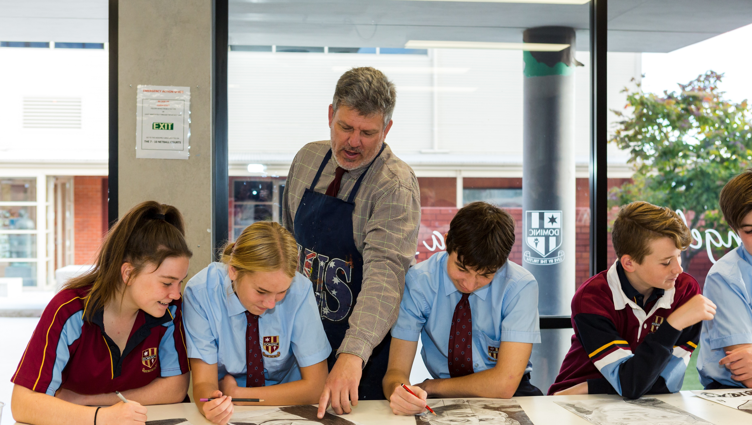
Year 8 Elective Subjects:
Visual Art
Drama
Dance
Music
Japanese
Food & Textiles Technology
Design in Wood
Design in Metal
Digital Technologies

Slide 10
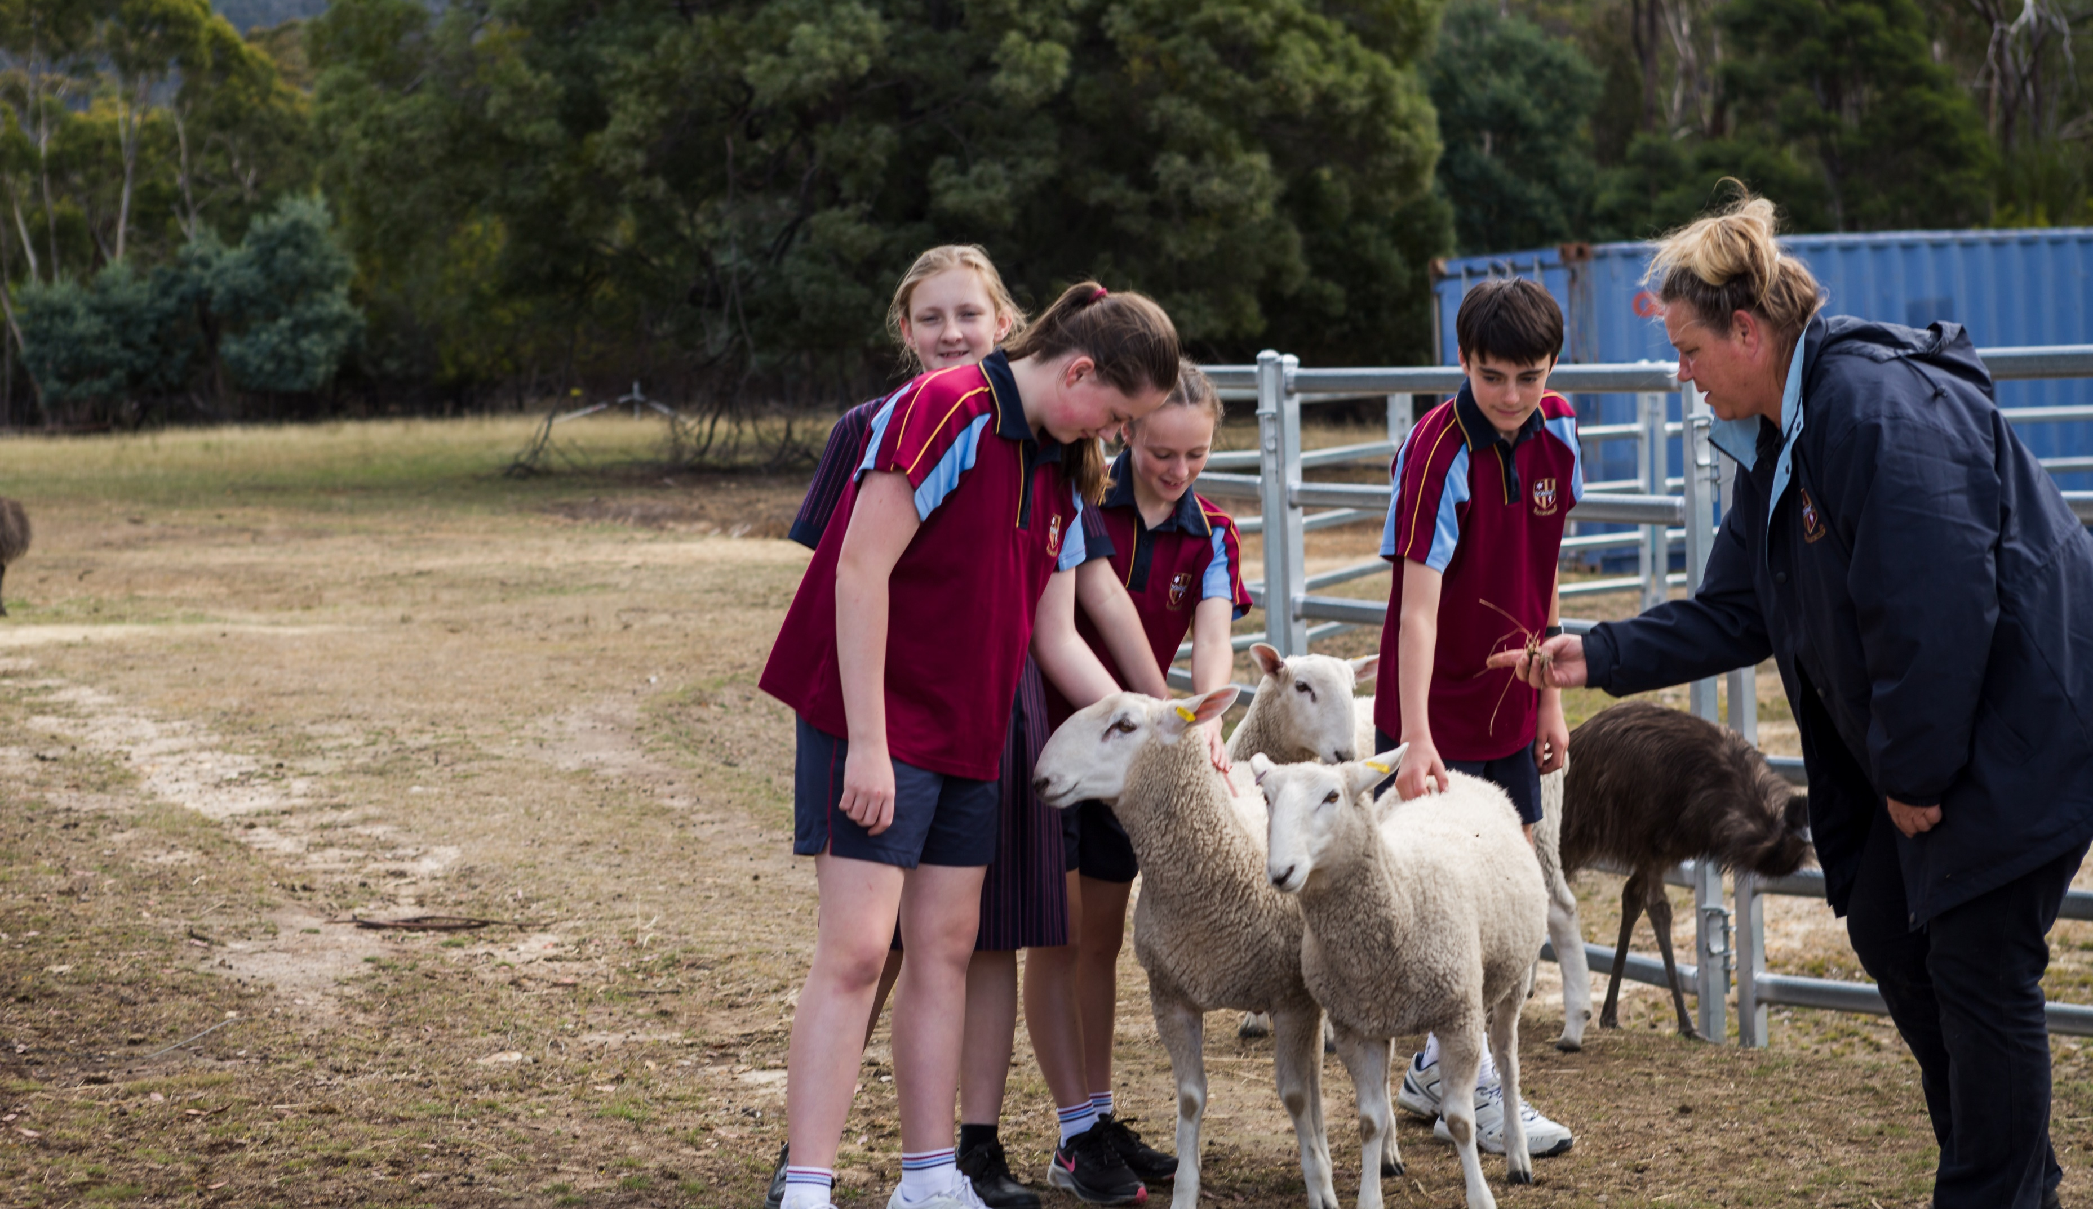
Year 9 & 10 Elective Subjects
English – Creative Writing
Mathematics – Mathematics Extension, Essential Maths, General Maths Preparatory Course and Maths 10A Plus
Humanities – Geography, Commerce, Intro to Psychology and Sociology, Japanese and Child Studies
Science – Physical Science, Life Science and Animal Husbandry & Marine Studies

Slide 11
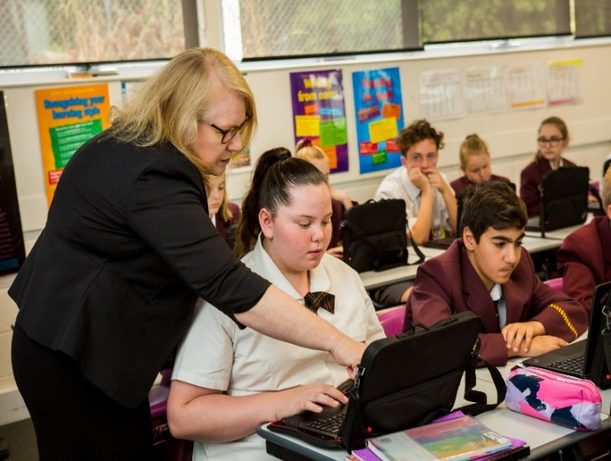
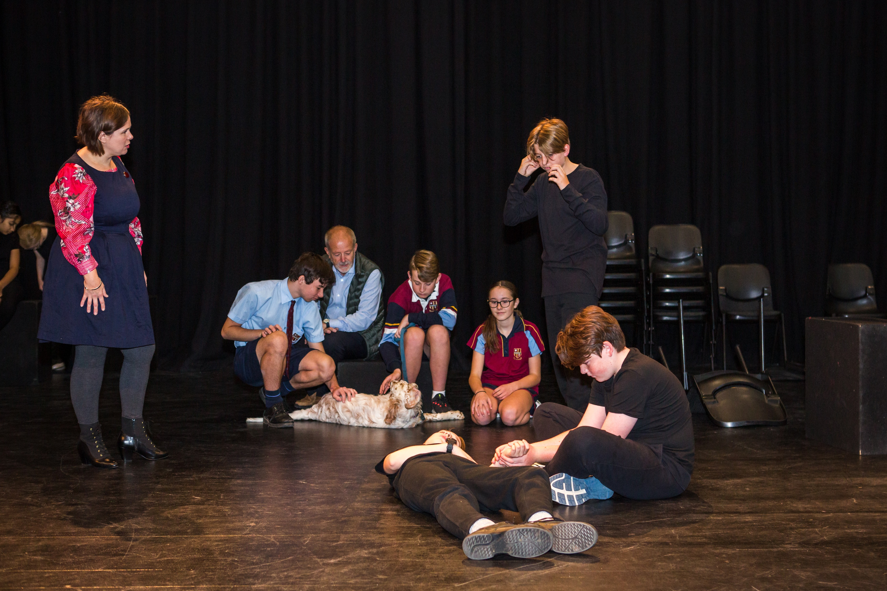
Year 9 & 10 Elective Subjects cont.
Health & PE – Athletic Development, Sport Science and Outdoor Education
Creative Arts – Visual Art, Drama, Dance, Media Arts and Music
Technology and Applied Studies – Information Technology, Robotics & Game Making, Food Technology, Computer Graphics, Design in Wood & Design in Metal

Slide 12
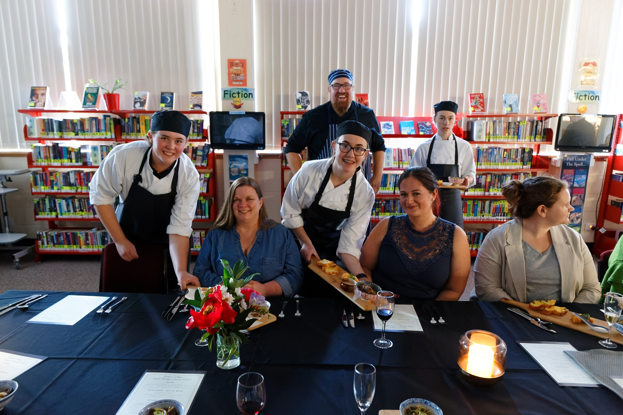
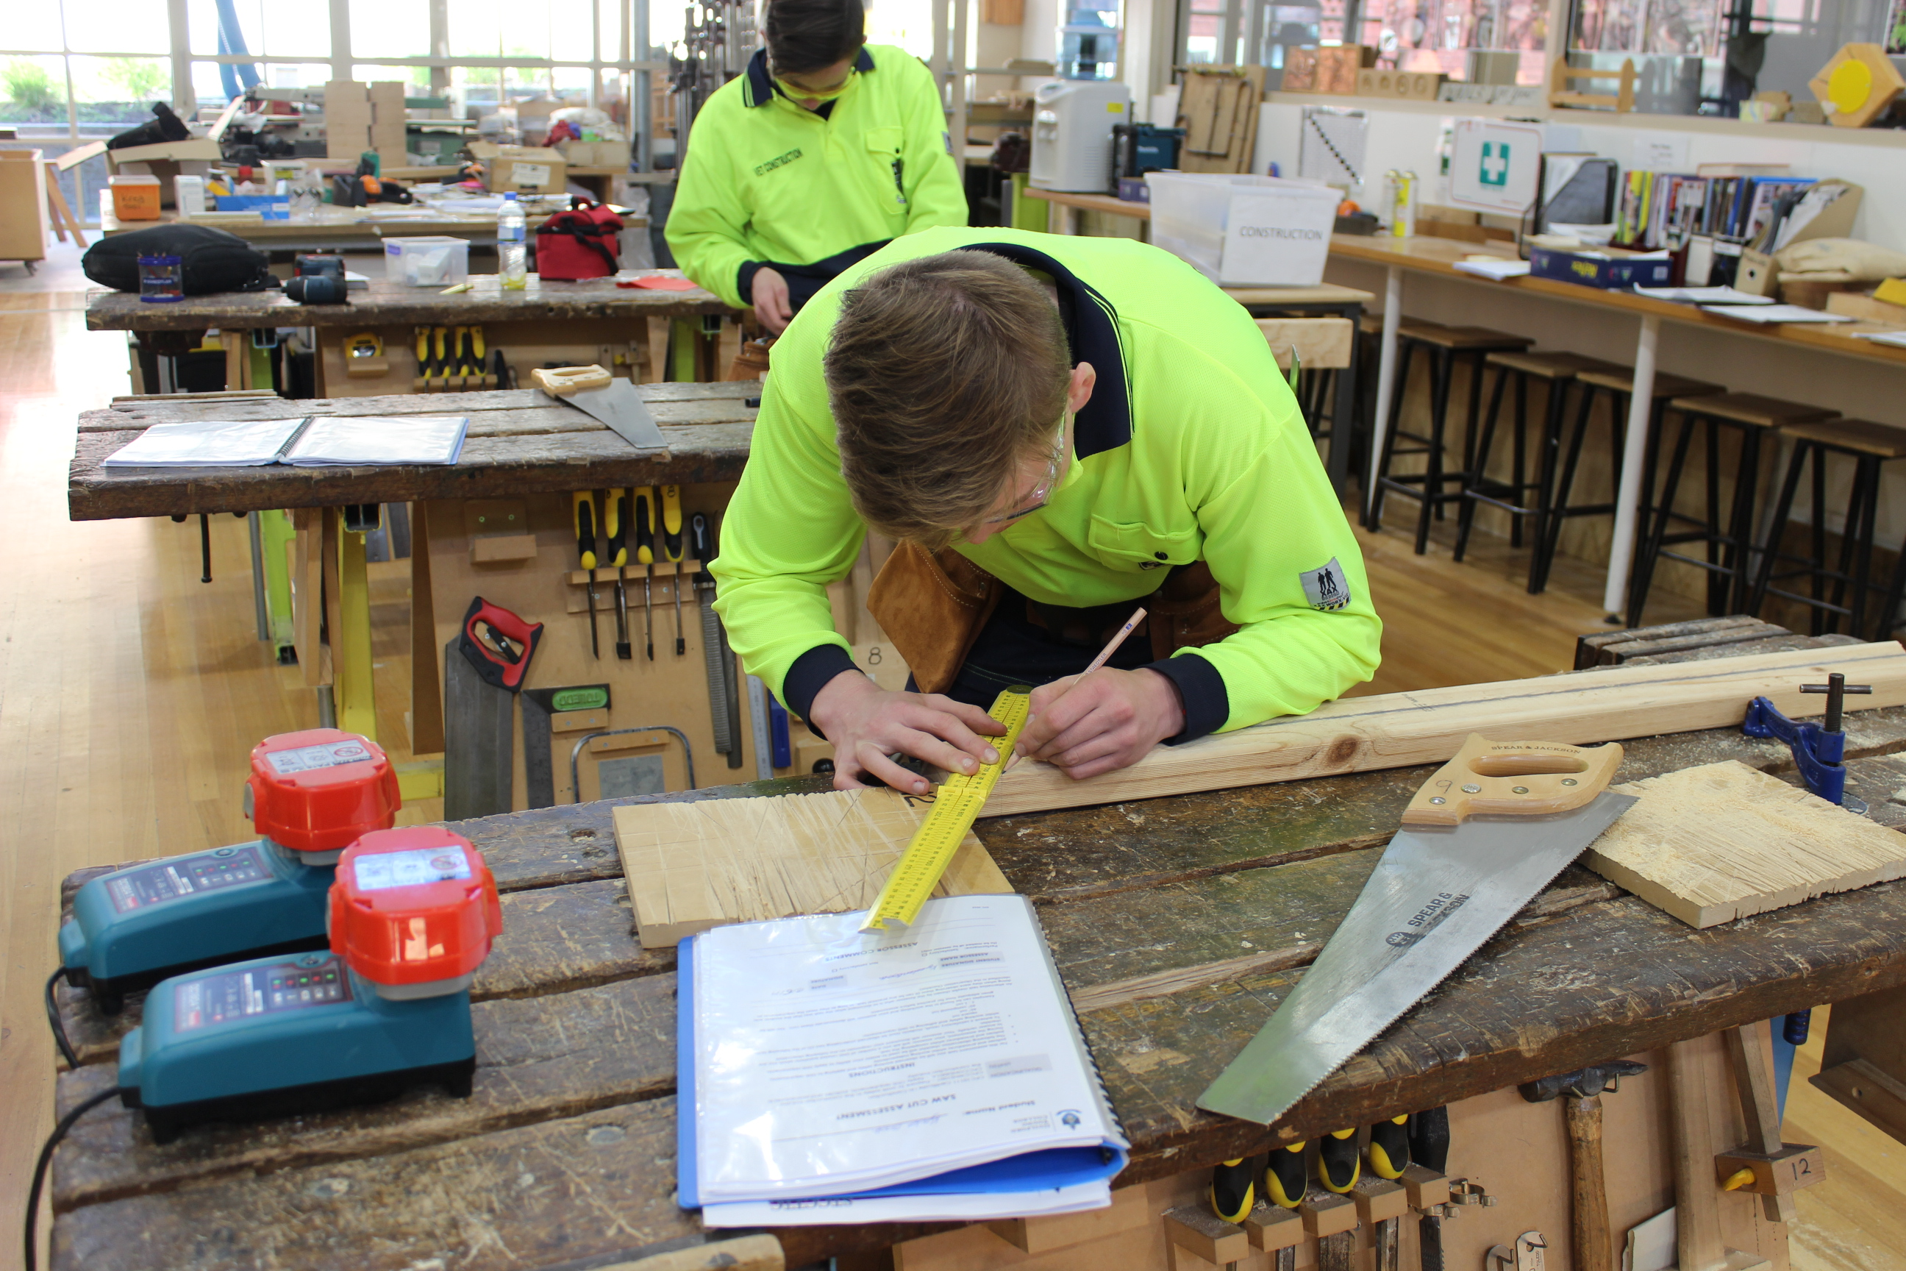
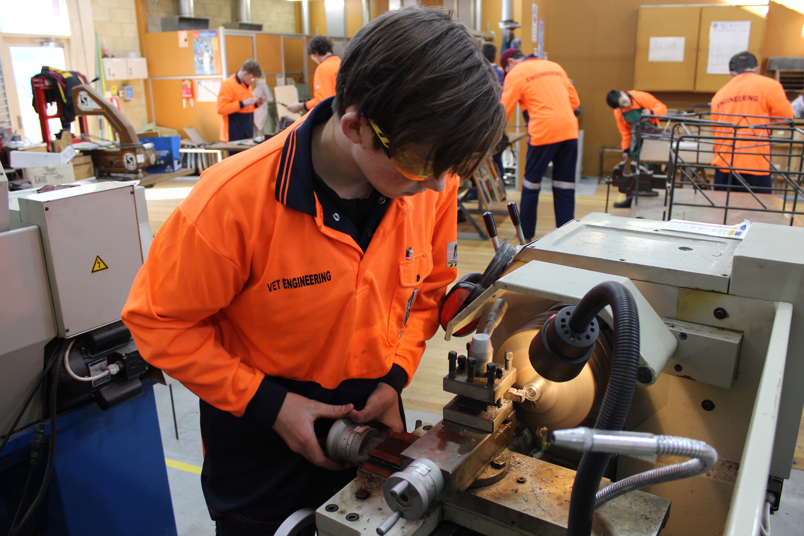
Year 9 & 10 VET Courses
Introduction to Construction
Introduction to Engineering Pathways
Introduction to Hospitality

Slide 13
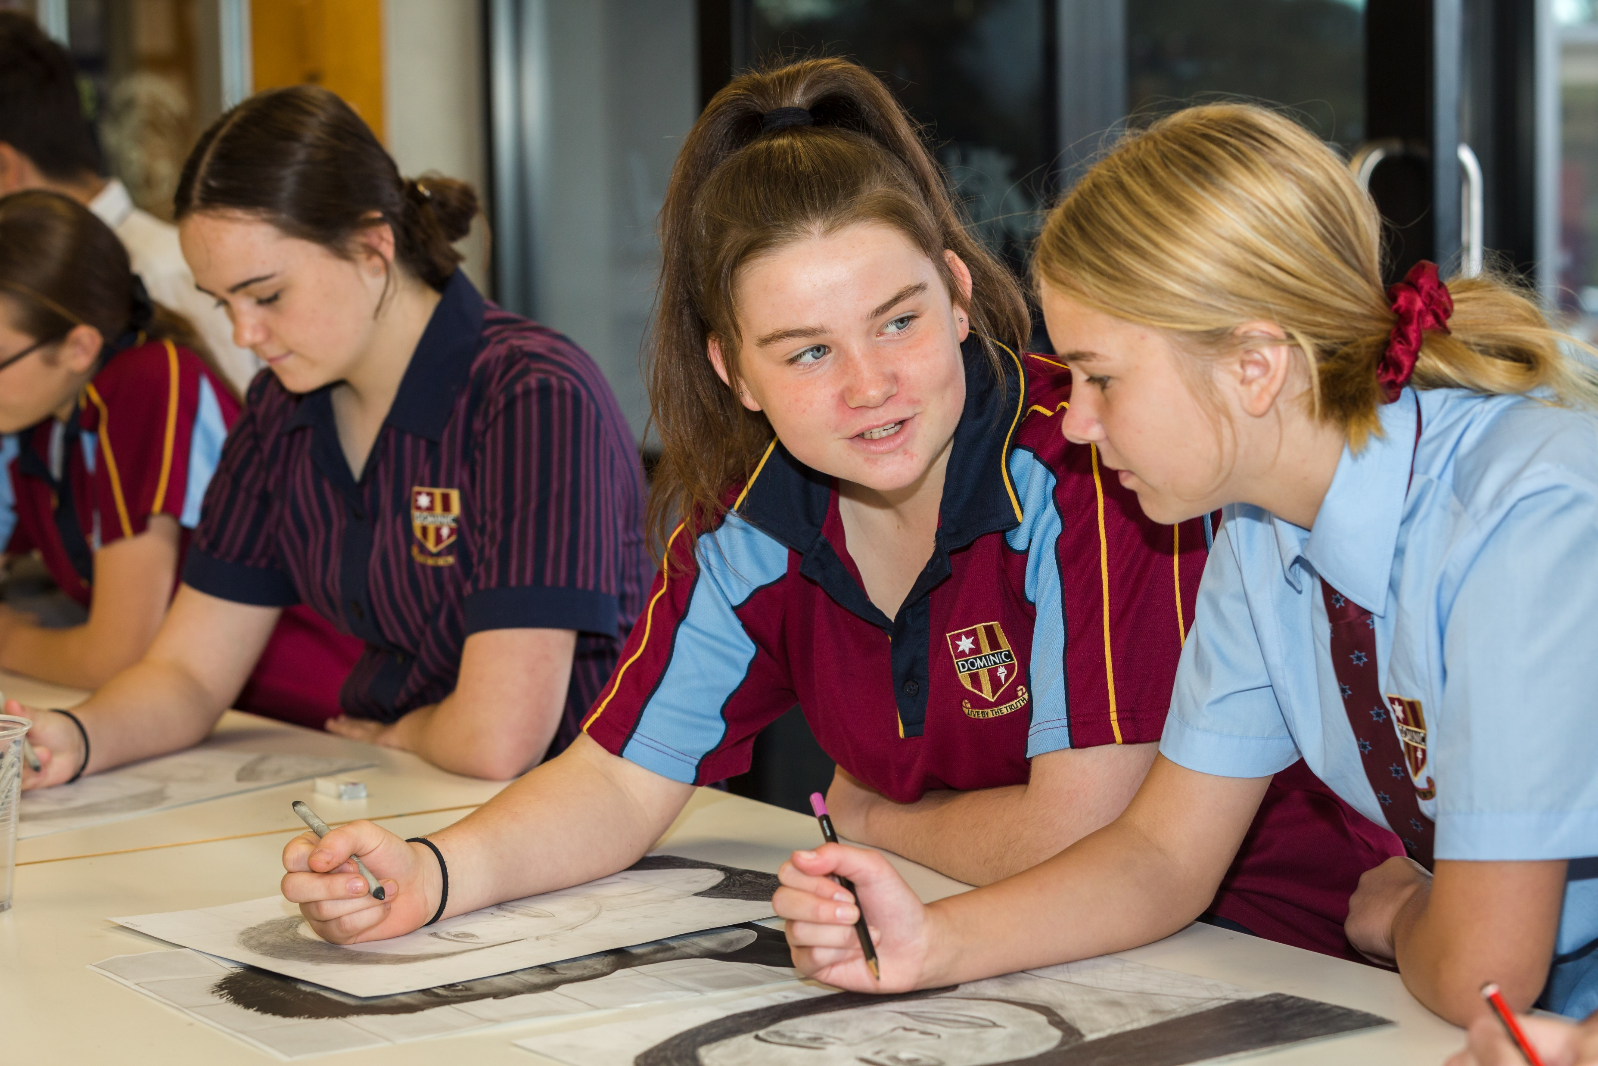

Slide 14
Thank You
Thank you for taking the time to carefully consider your elective choices for 2021.
Please feel free to contact:
Mrs. Janet Marcenko, Coordinator of Teaching and Learning 7-10
with any questions or concerns at jmarcenko@dominic.tas.edu.au

Slide 15
